Slide 1
The Cube³
Back
WARNING:
It appears that you are not presenting, in teams, or both. If so, please present outside of teams.
Now still in 2nd person!
DEMO
Part 2 of the spooky choose your own adventure
BEGIN
Part 1
Exit
Press to give opinion of story

Slide 2
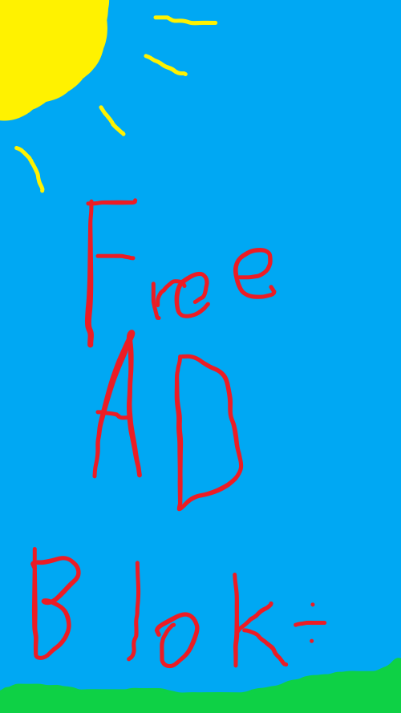
Shield Power
Deploy Loading System

Slide 3
Loading...
Back

Slide 4
Epilepsy warning
Skip
Continue
Nooo. Nope. Not at all.

Slide 5
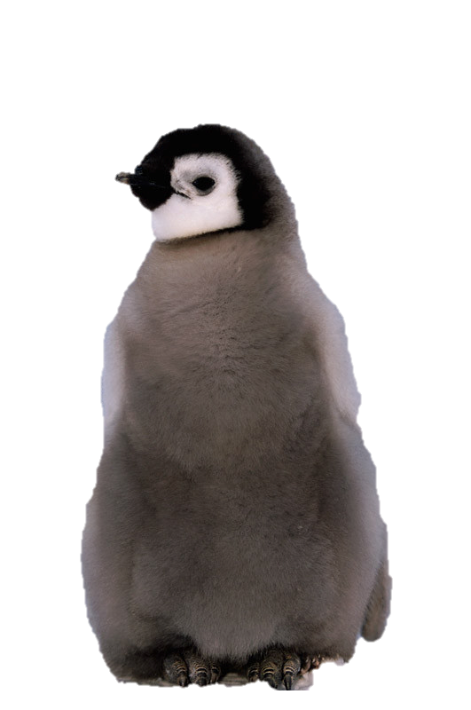
Loading...
Penguin Chick . Photograph. Britannica ImageQuest, Encyclopædia Britannica, 25 May 2016. quest.eb.com/images/149_2023667. Accessed 24 May 2023.

Slide 6
Start of the story
Back
You wake up to a glowing light outside your bedroom window.
Wait, this feels familiar.
Investigate
Go back to sleep

Slide 7
?
That, is because it is familiar.
Oh, ok.

Slide 8
Start of the story (option 1 removed)
Back
You wake up to a glowing light outside your bedroom window.
Investigate
Go back to sleep

Slide 9
Investigation
Back
You decide to investigate the glowing light outside your window... The light was coming from a glowing cube.
AHHHHHHHHHHHHHHHHHHHHHHHHHHHHHHHHHHHHHHH
Ok

Slide 10
More Investigation
Back
You wonder what you should do next...
Go outside
Faint

Slide 11
More Investigation Again
Back
You decide to go outside to look at the cube, it’s bobbing up and down next to your bedroom window.
Touch it
Call 911

Slide 12
Touching it more
Back
You touch the cube. It disappears and then reappears somewhere else... Almost as if it was leading you somewhere.
Keep following it

Slide 13
Following the cube
Back
You follow the cube, touching it each time. It leads you to...
<Continue>

Slide 14
Pause for dramatic effect
Menu
Area Loading...
Please Wait...
NO!
Skip

Slide 15
Not Following the cube
Back
...A small wooden shack. It looks old and decayed, but still standing. You wonder what is in it...
Enter
Uhmm... No?
Seriously?
Poke it!

Slide 16
Yes
Yes.
Very much yes.
Okay
Doubtful.

Slide 17
Poke it!
The shack collapses as you poke it. I guess it was on its last stand.
Oh.

Slide 18
hm
Back
You enter the wooden shack... It’s unsettlingly quiet and you can barely see the walls.
Whack the wall
???
Hey, what that button do?

Slide 19
No!
Back
No!
Oh.
But...

Slide 20
That button do thing
Back
You notice a button that was intentionally not mentioned in the previous option.
Literally, it’s to the left of “Hey, what that button do?”, and it’s *almost* invisible.
Press it!
But why was it not mentioned?

Slide 21
Beccccauseeeeeeeeeeeeeeeeeeeeeeee
Back
Because.....
Oh.
But...

Slide 22
No! but not.
Back
No!
Fine.
But...

Slide 23
Good job... Avoiding the entire story.
You skipped everything.
Retry
Menu

Slide 24
Whoops!
You just did that.
Retry
Menu

Slide 25
You’re Early! (You: Yay!)
Please wait until I’ve released The Cube FULLY.
(Check cat5.pythonanywhere.com on 9/5/23)

Slide 26
404 Slide actually not found
This isn’t a joke.
It is totally not a joke. Absolutely...
Dinner Bone
Back
Menu

